Slide 1

SOFTWARE ENGINEERING
Week 3
Introduction – Agile Software Processes

Slide 2
Agenda
Agility
Common Agile Practices
Extreme Programming
Scrum
Kanban - Scrumban

Slide 3

Agility
Agility
Common Agile Practices
Extreme Programming
Scrum
Kanban

Slide 4
Rapid Software Development
Rapid development and delivery is now often the most important requirement for software systems
Specification, design and implementation are inter-leaved
System is developed as a series of versions with stakeholders involved in version evaluation
User interfaces are often developed using an IDE and graphical toolset.
Notes:
Video 1

Slide 5
Agile Manifesto
“We are uncovering better ways of developing software by doing it and helping others do it. Through this work we have come to value:
Individuals and interactions over processes and tools
Working software over comprehensive documentation
Customer collaboration over contract negotiation
Responding to change over following a plan
That is, while there is value in the items on the right, we value the items on the left more.”
Kent Beck et al.
www.agilemanifesto.org

Slide 6
Principles of Agile Methods
Principle | Description
Customer involvement | Customers should be closely involved throughout the development process. Their role is provide and prioritize new system requirements and to evaluate the iterations of the system.
Incremental delivery | The software is developed in increments with the customer specifying the requirements to be included in each increment.
People not process | The skills of the development team should be recognized and exploited. Team members should be left to develop their own ways of working without prescriptive processes.
Embrace change | Expect the system requirements to change and so design the system to accommodate these changes.
Maintain simplicity | Focus on simplicity in both the software being developed and in the development process. Wherever possible, actively work to eliminate complexity from the system.

Slide 7
Common Agile Practices
Agility
Common Agile Practices
Extreme Programming
Scrum
Kanban

Slide 8
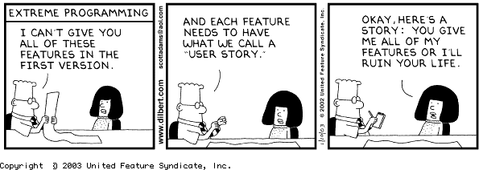
User Stories
In most of the agile methods, customer or user is part of the team and is responsible for making decisions on requirements.
User requirements are expressed as scenarios or user stories.
These are written on cards and the development team break them down into implementation tasks. These tasks are the basis of schedule and cost estimates.
The customer chooses the stories for inclusion in the next release based on their priorities and the schedule estimates.

Slide 9
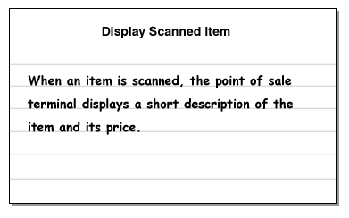
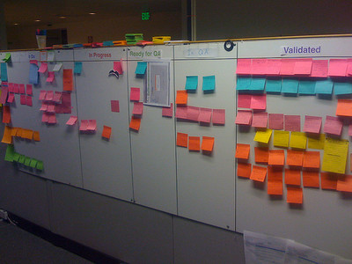

Story Boards

Slide 10
Story Points
Story point is an arbitrary measure used to measure the effort required to implement a story.
It is a number that tells the team how hard the story is. Hard could be related to complexity, unknowns and effort but not time
1, 2, 4, 8, 16, 32, 64
XS, S, M, L, XL, XXL
1, 2, 3, 5, 8, 13, 21, 34, 45
1, 5, 10, 25, 50, 100
For every team, story size could mean different things depending on what baseline they chose

Slide 11
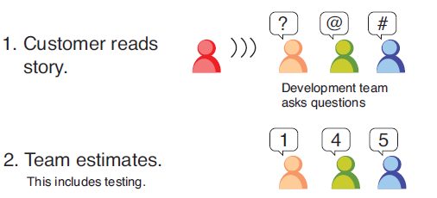
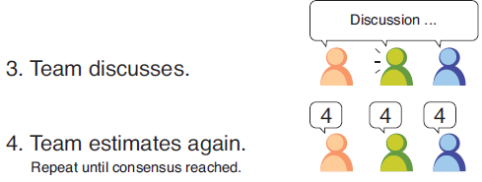
Planning Poker
Planning poker is a game where the development team estimates stories individually first and then compares the results collectively together after
If everyone’s estimate is more or less the same, the estimate is kept. If there are differences, however, the team discusses them and estimates again until consensus is reached.

Slide 12
Refactoring
Refactoring is the process of changing the design of your code without changing its behavior—what it does stays the same, but how it does changes.
You can think of it like improving a function-method-class without changing its interface.
However, some changes requires architecture refactoring and this is much more expensive.
Examples of refactoring:
Re-organization of a class hierarchy to remove duplicate code.
Tidying up and renaming attributes and methods to make them easier to understand.
The replacement of inline code with calls to methods that have been included in a program library.

Slide 13
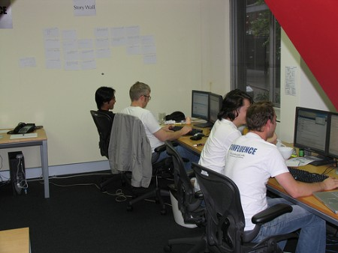

Pair Programming Environment

Slide 14
Advantages of Pair Programming
It supports the idea of collective ownership and responsibility for the system.
Individuals are not held responsible for problems with the code. Instead, the team has collective responsibility for resolving these problems.
It acts as an informal review process because each line of code is looked at by at least two people.
It helps support refactoring, which is a process of software improvement.
Where pair programming and collective ownership are used, others benefit immediately from the refactoring so they are likely to support the process.

Slide 15
Collective Ownership
Collective code ownership spreads responsibility for maintaining the code to all the programmers. Collective code ownership is exactly what it sounds like: everyone shares responsibility for the quality of the code.
No single person claims ownership over any part of the system, and anyone can make any necessary changes anywhere.
Collective code ownership requires letting go of a little bit of ego. Rather than taking pride in your code, take pride in your team’s code.
Always leave the code a little better than you found it.

Slide 16
Collective Ownership
How can you take ownership of code that you don’t understand?
take advantage of pair programming
Rely on the unit tests for further documentation and as your safety net
As you work, look for opportunities to refactor the code.
Collective code ownership shares knowledge and improves skills, but it won’t make everyone an expert at everything. Take advantage of all skills and specialties.
Rather than turning your junior programmers loose on the code, make sure they pair with experienced members of the team.
Collective ownership increases the possibility of merge conflicts, and so it also requires continuous integration. Continuous integration decreases the chances of merge conflicts.

Slide 17
Continuous Integration
The ultimate goal of continuous integration is to be able to deploy all but the last few hours of work at any time.
Most software development efforts have a hidden delay between when the team says “we’re done” and when the software is actually ready to ship.
The point is to be technologically ready to release even if you’re not functionally ready to release.
Integrate your code every few hours.
Keep your build, tests, and other release infrastructure up-to-date.
To guarantee an always-working build
make sure what works on your computer will work on anybody’s computer.
nobody gets code that hasn’t been proven to build successfully.

Slide 18
Continuous Integration
There’s a lively community of open-source continuous integration servers
CruiseControl
Jenkins
TeamCity

Slide 19
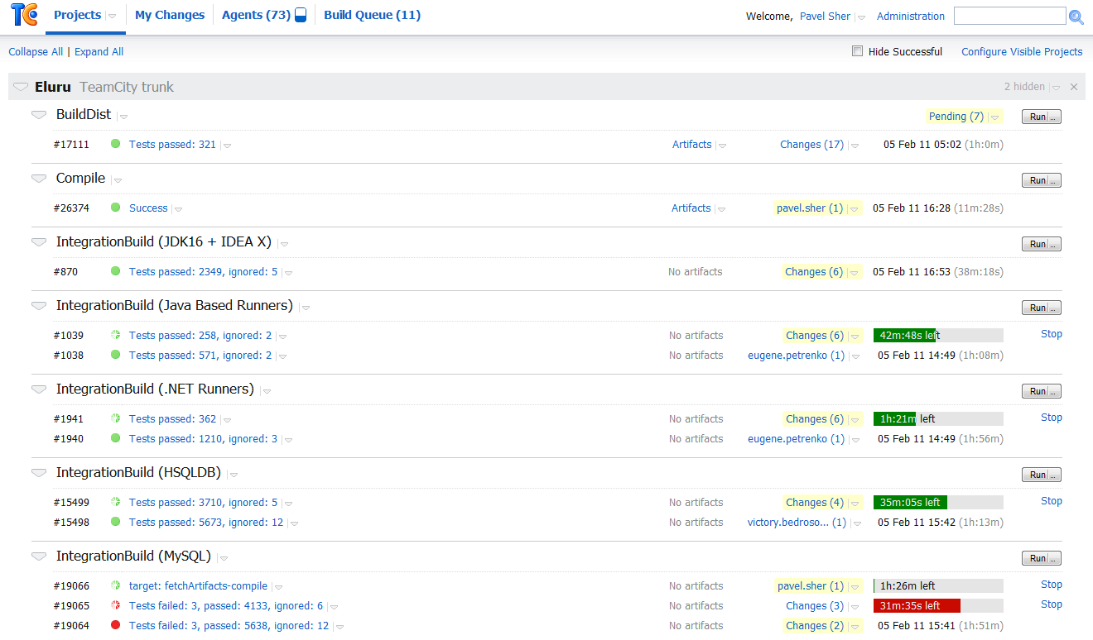
Continuous Integration

Slide 20
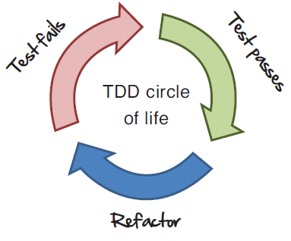
Test Driven Development
Test-driven development (TDD) is a software development technique that uses really short development cycles to incrementally design your software.
Red: Before you write any new code for the system, you first write a failing unit test, showing the intent of what you would like the new code to do. Here you are thinking critically about the design.
Green: Then you do whatever it takes to make the test pass. If you see the full implementation, add the new code. If you don’t, do just enough to get the test to pass.
Refactor: Then you go back and clean up any code while trying to get the test to pass.

Slide 21
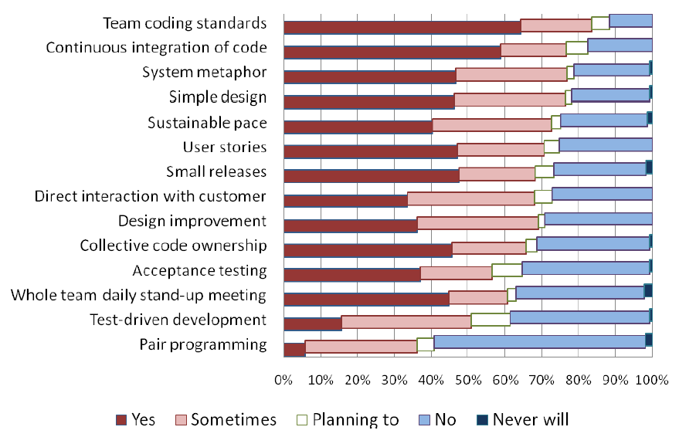
Overall Usage

Slide 22
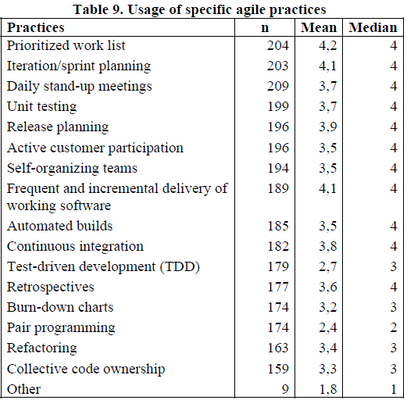
Overall Usage

Slide 23
Extreme Programming
Agility
Extreme Programming
Scrum
Other Agile Methodologies
Agility
Common Agile Practices
Extreme Programming
Scrum
Kanban

Slide 24
Extreme Programming
The most widely used agile process, originally proposed by Kent Beck
Extreme Programming (XP) takes an ‘extreme’ approach to iterative development.
New versions may be built several times per day;
Increments are delivered to customers every 2 weeks;
All tests must be run for every build and the build is only accepted if tests run successfully.
Notes:
Video 2

Slide 25
XP Principles
Incremental development is supported through small, frequent system releases.
Customer involvement means full-time customer engagement with the team.
People not process through pair programming, collective ownership and a process that avoids long working hours.
Change supported through regular system releases.
Maintaining simplicity through constant refactoring of code.

Slide 26
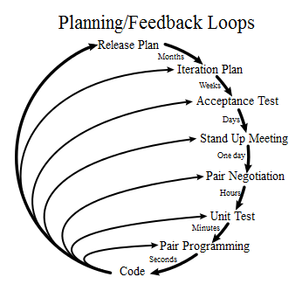
XP loops

Slide 27
XP Phases
XP Planning
Begins with the creation of “user stories”
Agile team assesses each story and assigns an cost
Stories are grouped to for a deliverable increment
A commitment is made on delivery date
After the first increment “project velocity” is used to help define subsequent delivery dates for other increments
XP Design
Follows the KIS principle
Encourage the use of CRC cards
For difficult design problems, suggests the creation of “spike solutions”—a design prototype
Encourages “refactoring”—an iterative refinement of the internal program design
XP Coding
Recommends the construction of a unit test for a store before coding commences
Encourages “pair programming”
XP Testing
All unit tests are executed daily
“Acceptance tests” are defined by the customer and executed to assess customer visible functionality

Slide 28
Scrum
Agility
Extreme Programming
Scrum
Other Agile Methodologies
Agility
Common Agile Practices
Extreme Programming
Scrum
Kanban

Slide 29
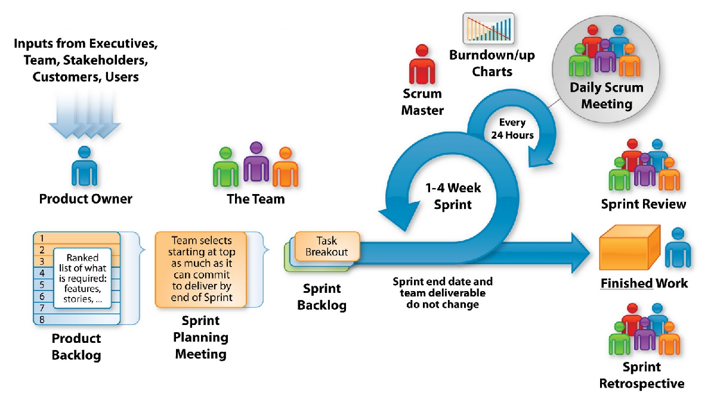
Scrum Process

Slide 30
Scrum Process
Scrum Events
Sprint Planning Meeting
Daily Scrum
Sprint Review
Sprint Retrospective
The Scrum Team
The Product Owner
The Development Team
The Scrum Master
Scrum Artifacts
Product Backlog
Sprint Backlog
Increment

Slide 31
Scrum Master
Scrum Master performs following duties
Service to the Product Owner
Finding techniques for effective Product Backlog management;
Clearly communicating vision, goals, and Product Backlog items to the Development Team;
Understanding long-term product planning in an empirical environment;
Service to the Development Team
Coaching the Development Team in self-organization and cross-functionality
Removing impediments to the Development Team’s progress;
Facilitating Scrum events as requested or needed
Service to the Organization
Leading and coaching the organization in its Scrum adoption and implementations
Causing change that increases the productivity of the Scrum Team
Working with other Scrum Masters

Slide 32
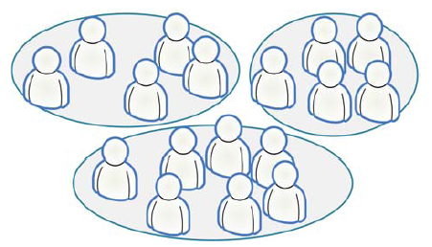
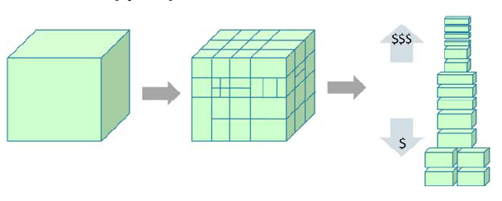
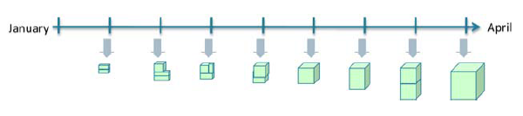
Scrum in a Nutshell
Split your organization into small, cross-functional, self-organizing teams.
Split your work into a list of small, concrete deliverables. Sort the list by priority and estimate the relative effort of each item.
Split time into short fixed-length iterations (usually 1 – 4 weeks), with potentially shippable code demonstrated after each iteration.
Optimize the release plan and update priorities in collaboration with the customer, based on insights gained by inspecting the release after each iteration.
Optimize the process by having a retrospective after each iteration.

Slide 33
Kanban
Agility
Extreme Programming
Scrum
Other Agile Methodologies
Agility
Common Agile Practices
Extreme Programming
Scrum
Kanban

Slide 34
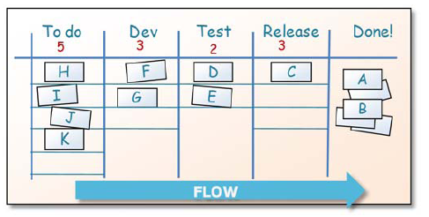
Kanban in a Nutshell
Visualize the workflow
Limit Work In Progress (WIP) – assign explicit limits to how many items may be in progress at each workflow state.
Measure the lead time (average time to complete one item, sometimes called “cycle time”), optimize the process to make lead time as small and predictable as possible.

Slide 35
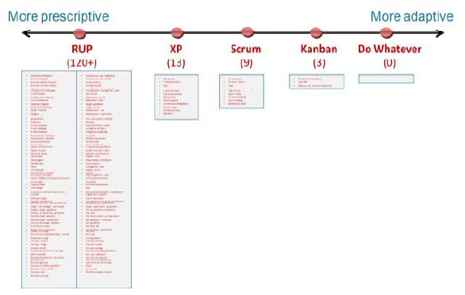
Kanban in a Nutshell
Visualize the workflow
Limit Work In Progress (WIP) – assign explicit limits to how many items may be in progress at each workflow state.
Measure the lead time (average time to complete one item, sometimes called “cycle time”), optimize the process to make lead time as small and predictable as possible.

Slide 36
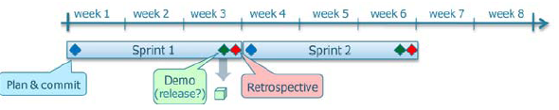
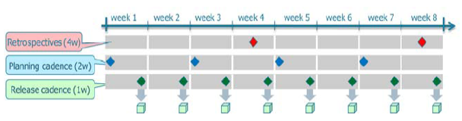
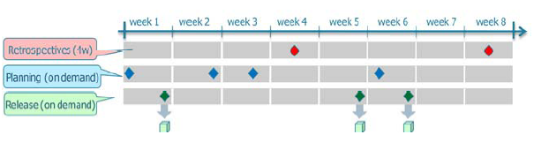
Scrum vs Kanban
Scrum is more prescriptive
Kanban doesn’t prescribe any roles at all.
In Kanban time-boxed iterations are not prescribed. You can go using
Single Scrum iterations
Multiple periodic cadences
Multiple Event-driven cadences. E.g. We trigger a release whenever there is a set of Minimum Marketable Features (MMFs) ready for release

Slide 37
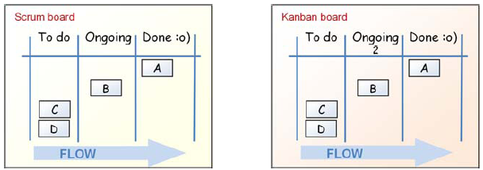
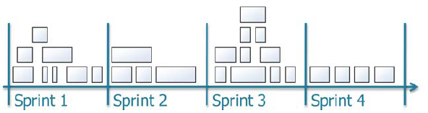
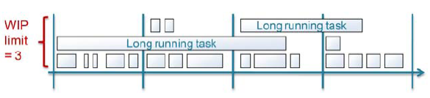
Scrum vs Kanban
Kanban limits WIP per workflow state, Scrum limits WIP per iteration.
Scrum board is reset between each sprint
Scrum prescribes cross-functional teams, Kanban boards are cross-team
Scrum backlog items must fit in a sprint

Slide 38
Scrum – Kanban Similarities
Both use a pull based system
Both allow working on multiple products simultaneously
Both are empirical

Slide 39
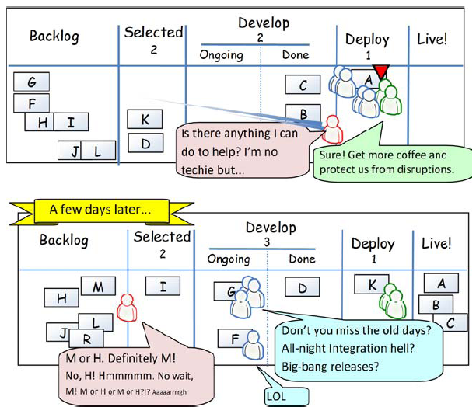
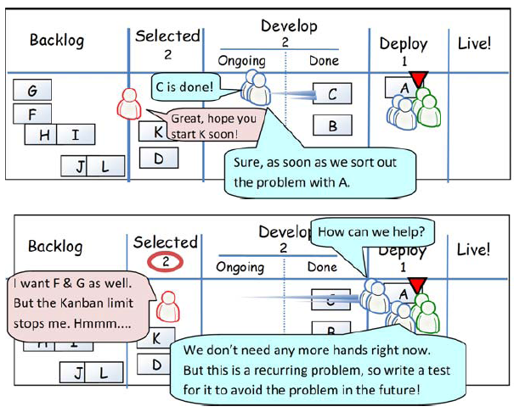
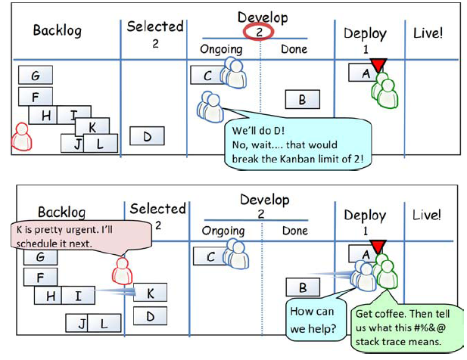
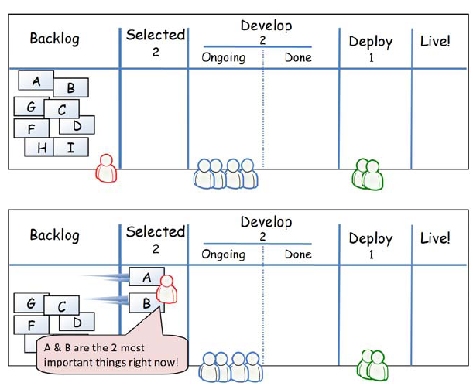
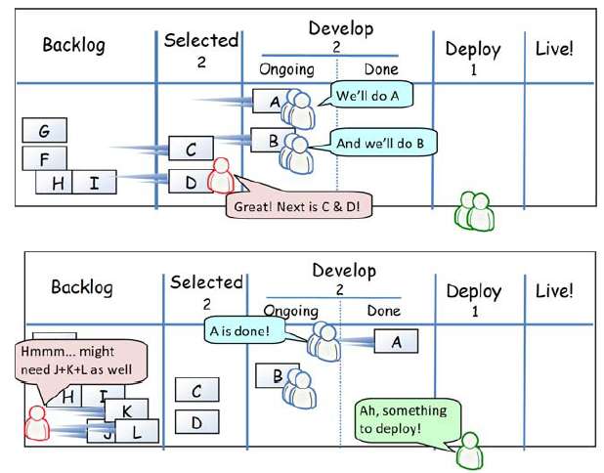
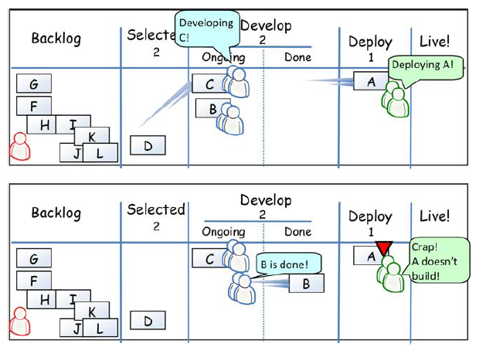
One Day in Kanban

Slide 40
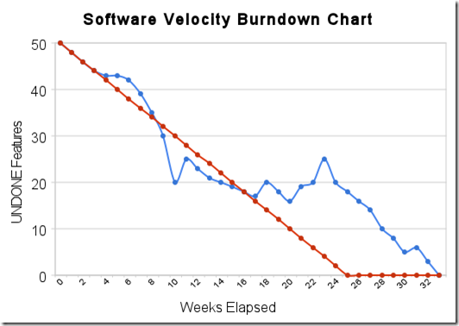
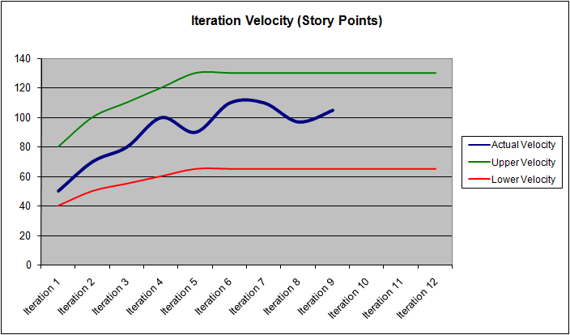
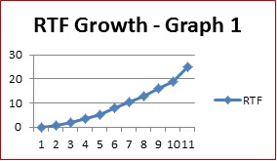
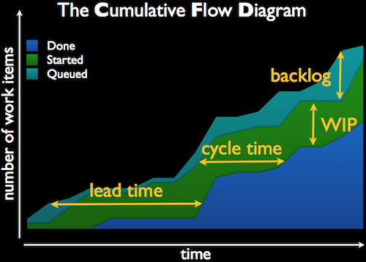
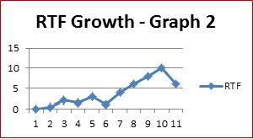
Scrum-Agile Metrics
Burndown Chart
Velocity
Running Tested Feat.
Cumulative Flow Dia.

Slide 41
Problems with agile methods
It can be difficult to keep the interest of customers who are involved in the process.
Team members may be unsuited to the intense involvement that characterizes agile methods.
Prioritizing changes can be difficult where there are multiple stakeholders.
Maintaining simplicity requires extra work.
Contracts may be a problem as with other approaches to iterative development.

Slide 42
Agile Methods Applicability
Product development where a software company is developing a small or medium-sized product for sale.
Custom system development within an organization, where there is a clear commitment from the customer to become involved in the development process and where there are not a lot of external rules and regulations that affect the software.
Because of their focus on small, tightly-integrated teams, there are problems in scaling agile methods to large systems.

Slide 43
Agile vs Plan-Driven Methods
Plan-driven development
Agile development
A plan-driven approach to software engineering is based around separate development stages with the outputs to be produced at each of these stages planned in advance.
Not necessarily waterfall model – plan-driven, incremental development is possible
Iteration occurs within activities.
Specification, design, implementation and testing are inter-leaved and the outputs from the development process are decided through a process of negotiation during the software development process

Slide 44
Agile vs Plan-Driven Methods
Agile | Plan-driven | Formal Methods
Expert Developers | Junior Developers | Expert Developers
Frequent Changes | Rare Changes | Constrained Changes
Few Developers | Large Groups Of Developers | Modellable Requirements
Chaotic Work Environment | Tidy Work Environment | High Quality Product
Low Critical Systems | High Critical Systems | Very High Critical Systems

Slide 45
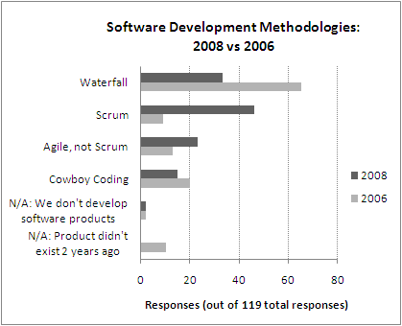
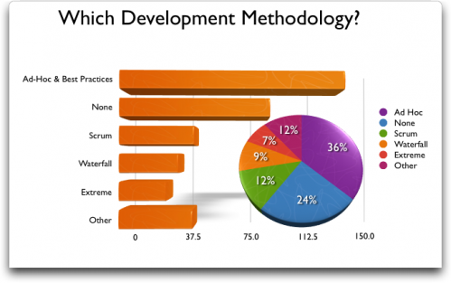

Slide 46
Wrap-up
This week we present
The concept of agility
Agile Practices
Most frequently used agile methodologies
XP
Scrum
Kanban
Best suggestion
Select practices and methodology based on organizational characteristics and experience level.

Slide 47
Next Week
We will present an in-depth discussion on Software Project Planning and Estimation!!!

